Slide 1
Discrete Mathematics
South China University of Technology
1

Slide 2
Chapter 8. Graphs
Representing Graphs and Graph Isomorphism
Section 8.3
2

Slide 3
Contents
1
Adjacency and Incidence Matrices
2
Isomorphism of Graphs
3

Slide 4
Representing Graphs
4

Slide 5
Adjacency Lists of Simple Graphs
A table with 1 row per vertex, listing its adjacent 邻接 vertices.
a
b
c
d
e
f

Slide 6
Adjacency Lists of Directed Graphs
A table with 1 row per vertex, listing its adjacent vertices.
a
b
c
d
e
f

Slide 7
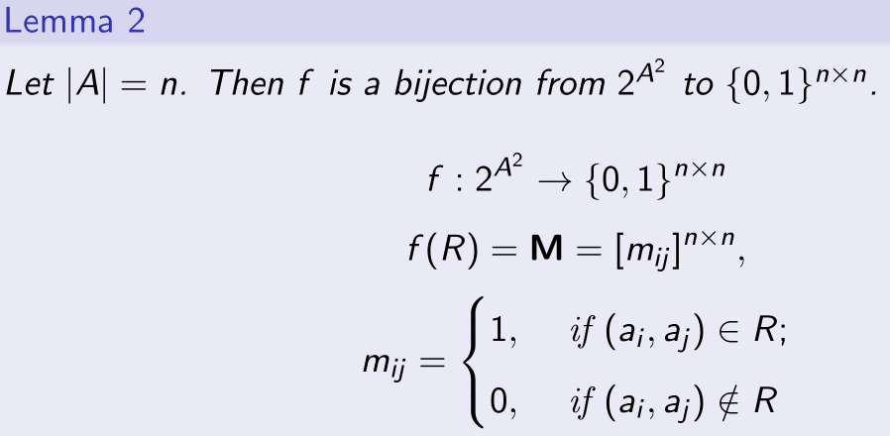
Review relation and matrix

Slide 8
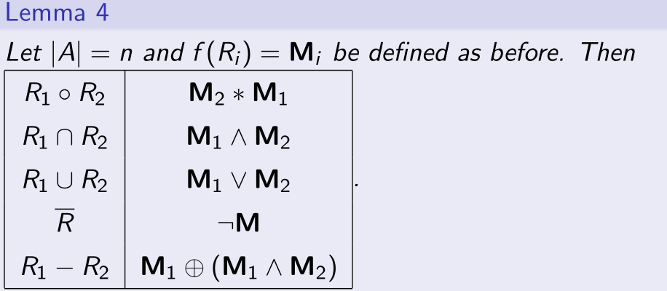
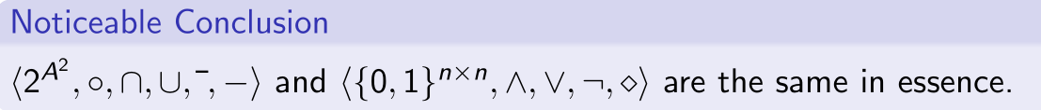
Useful fact

Slide 9
Review relation and digraph
Digraph G=(V, E) and relation R:
E = R
What about undirected graph G=(V, E) and relation R ?

Slide 10
Adjacency Matrix
Suppose that G＝<V, E> is a simple graph where |V|＝n.
The adjacency matrix A (or AG) of G is the zero-one matrix

Slide 11
Example 3
Use an adjacency matrix to represent the graph.
a
b
c
d

Slide 12
simple graph’s properties
symmetric,
if there are relatively few edges in a graph, the adjacency matrix is a sparse matrix, that is, a matrix with few nonzero entries.

Slide 13
Example 4
Draw a graph with the adjacency matrix
a
b
c
d

Slide 14
Example 5 multigraph’s Adjacency Matrix
When multiple edges are present, the (i, j)th entry of this matrix equals the number of edges that are associated to
a
b
c
d

Slide 15
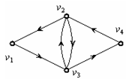
Digraph’s Adjacency Matrix

Slide 16
Incidence Matrices 关联矩阵
Let G＝<V, E> be an undirected graph.
Then the incidence matrix is a n x m matrix :

Slide 17
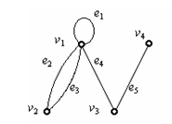

Slide 18
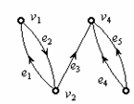
Directed Graphs

Slide 19
Isomorphism of Graphs
19

Slide 20
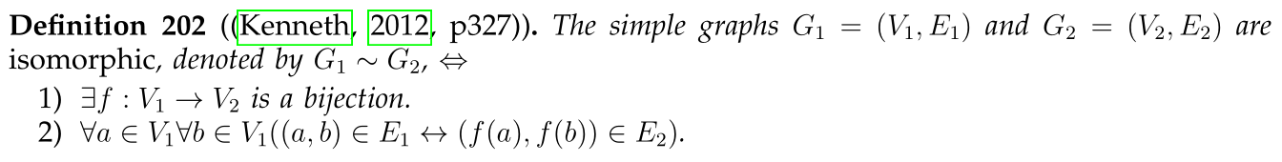
An equivalence relation between graphs
A given graph (V,E) may be drawn in different ways.
Two graphs are isomorphic iff they are identical except for their node names.
This definition can be extended to other types of graphs.

Slide 21
Graph Invariants under Isomorphism
If G₁=(V₁, E₁) ~ G₂=(V₂, E₂), then:
|V1|=|V2|
|E1|=|E2|.
The number of vertices with degree n is the same in both graphs.
For every proper subgraph g₁ ⊆ G₁, there is a proper subgraph g₂ ⊆ G₂ that g₂ ~ g₁.
Necessary conditions.

Slide 22
Isomorphism Example
If isomorphic, label the 2nd graph to show the isomorphism, else identify difference.
d
b
a
b
a
d
c
e
e
c
f
f

Slide 23
Are These Isomorphic?
If isomorphic, label the 2nd graph to show the isomorphism, else identify difference.
Same # of vertices
a
b
Same # of edges
d
Different # of verts of degree 2! (1 vs 3)
c
e

Slide 24
Isomorphism of Graphs
Example 8: G=(V, E) and H=(W, F)
u1
u2
v1
v2
u3
u4
v3
v4
G
H

Slide 25
Isomorphism of Graphs
Example 9: G and H
b
b
a
c
a
c
e
G
d
e
H
d
G has no vertices of degree one, but H has one.

Slide 26
Isomorphism of Graphs
Example 10: G and H
a
b
s
t
e
f
w
x
h
g
z
y
v
u
d
G
c
G
They also both have four vertices of degree two and four of degree three. Are they isomorphism?
Conceivable!!

Slide 27
Isomorphism of Graphs
a
b
s
t
e
f
w
x
h
g
z
y
v
u
d
G
c
G
However, their adjacent vertices are different for their degrees are different.
Not isomorphism!!

Slide 28
Not isomorphism example
Another way is to note that the subgraphs of G and H made up of vertices of degree 3.
if these two graphs are isomorphic, the edges connecting them must be isomorphic

Slide 29
Isomorphism of Graphs
b
a
b
s
t
s
e
f
w
x
w
h
f
h
g
z
y
z
v
d
v
u
G
c
G
subgraphs of vertices of degree 3 are different.
Not isomorphism!!

Slide 30
Isomorphism of Graphs
u1
u2
v1
v3
v2
u6
u5
v6
u4
v5
v4
G
u3
H
G and H have 6 vertices and 7 edges. Both have 4 vertices of degree 2 and 2 vertices of degree 3.
The subgraphs of G and H consisting of all vertices of degree 3 and the edges connecting them are isomorphic.
Conceivable!!

Slide 31
If f is isomorphism, we can show that the adjacency matrix of G is the same as the adjacency matrix of H with corresponding rows and columns.

Slide 32
Adjacency Matrix of G
u1
u2
u6
u5
u4
G
u3

Slide 33
Adjacency Matrix of H
v1
v3
v2
v6
v5
v4
H

Slide 34
Isomorphism of Graphs
u1
u2
v1
v3
v2
u6
u5
v6
u4
v5
v4
G
u3
H
u1’s adjacency vertices (u2 and u4) have 3 degree.
v6 or v4.
Try f(u1)=v6, f(u2)=v3, f(u3)=v4, f(u4)=v5
f(u5)=v1, f(u6)=v2

Slide 35
f(u1)=v6, f(u2)=v3, f(u3)=v4, f(u4)=v5, f(u5)=v1, f(u6)=v2

Slide 36
Graph Isomorphism
The best algorithms known for determining whether two graphs are isomorphic have O(2^{n}) worst-case time complexity.
Linear average-case time complexity for some
Polynomial worst-case time complexity is hoped
The best algorithm is called NAUTY, which uses less than one second in determining two 100-vertex graphs are isomorphic.

Slide 37
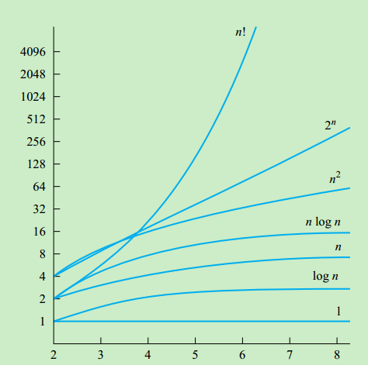
Time Complexity
The are n! possible one-to-one correspondences between the vertex sets of two simple graphs with n vertices.
we can often show that two simple graphs are not isomorphic via Graph Invariants.

Slide 38
作业题提示
Prove:简单图的同构关系是等价关系

Slide 39
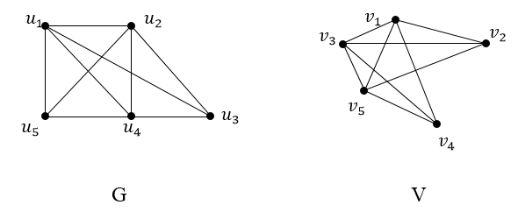
历史上的考题
Determine whether graphs G and V are isomorphic. If isomorphic, show the isomorphic function, else identify their difference.

Slide 40
10, 14, 18, 21,22

Slide 41
End of Section 8.3
Click to edit company slogan .
41

